Slide 1
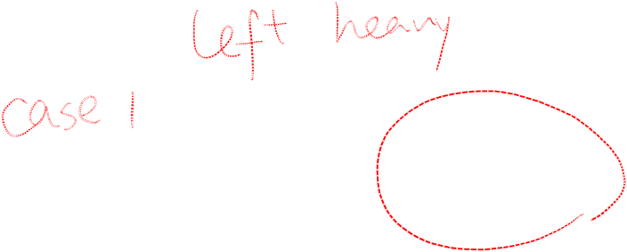
AVL Tree Example:
Insert 14, 17, 11, 7, 53, 4, 13 into an empty AVL tree
14
11
17
7
53
4

Slide 2
AVL Tree Example:
Insert 14, 17, 11, 7, 53, 4, 13 into an empty AVL tree
14
7
17
4
11
53
13

Slide 3
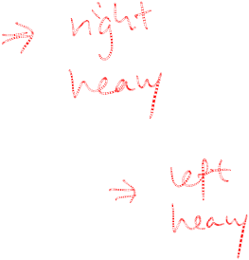
AVL Tree Example:
Now insert 12
14
7
17
4
11
53
13
12

Slide 4
AVL Tree Example:
Now the AVL tree is balanced.
14
7
17
4
12
53
11
13

Slide 5

AVL Tree Example:
Now insert 8
14
7
17
4
12
53
11
13
8

Slide 6
AVL Tree Example:
Now the AVL tree is balanced.
14
11
17
7
12
53
4
8
13

Slide 7
AVL Tree Example:
Now remove 53
14
11
17
7
12
53
4
8
13

Slide 8

AVL Tree Example:
Now remove 53, unbalanced
14
11
17
7
12
4
8
13

Slide 9
AVL Tree Example:
Balanced! Remove 11
11
7
14
4
8
12
17
13

Slide 10
AVL Tree Example:
Remove 11, replace it with the largest in its left branch
8
7
14
4
12
17
13

Slide 11
AVL Tree Example:
Remove 8, unbalanced
7
4
14
12
17
13

Slide 12
AVL Tree Example:
Balanced!!
12
7
14
4
13
17

Slide 13
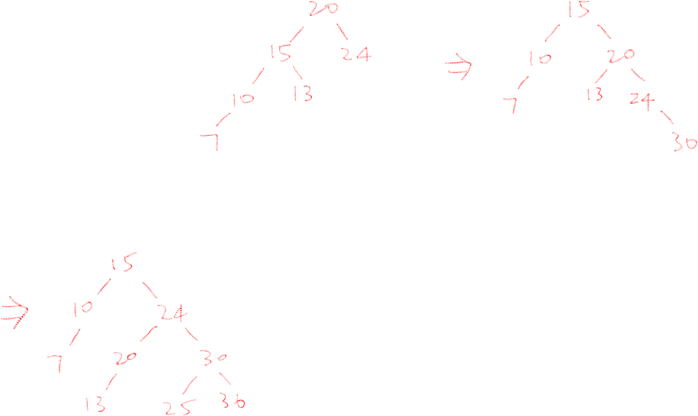


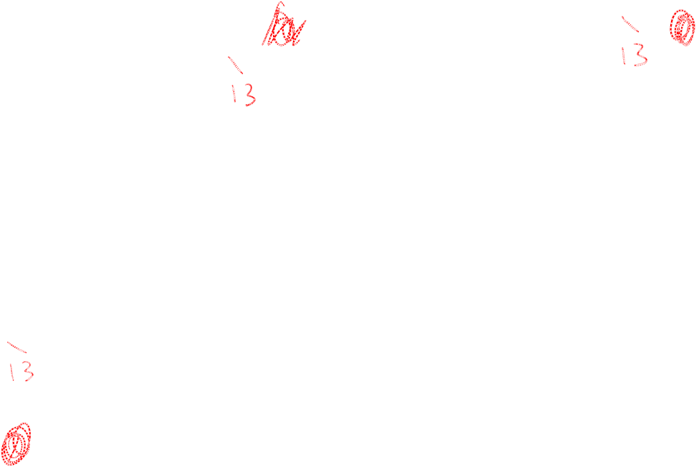
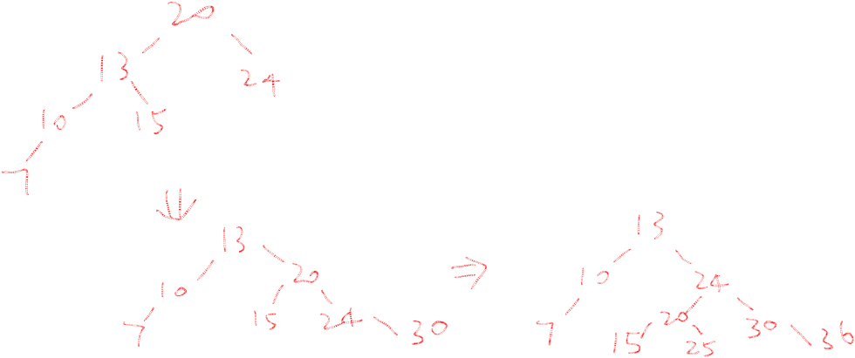


In Class Exercises
Build an AVL tree with the following values:
  15, 20, 24, 10, 13, 7, 30, 36, 25

Slide 14
  15, 20, 24, 10, 13, 7, 30, 36, 25
20
15
15
24
20
10
24
13
20
20
13
24
15
24
10
15
13
10

Slide 15
  15, 20, 24, 10, 13, 7, 30, 36, 25
20
13
13
24
10
20
10
15
7
15
24
7
30
13
36
10
20
7
15
30
24
36

Slide 16
  15, 20, 24, 10, 13, 7, 30, 36, 25
13
13
10
20
10
20
7
15
30
7
15
24
24
36
30
25
13
25
36
10
24
7
20
30
15
25
36

Slide 17
Extra exercise: remove 24, remove 20

Slide 18
  Remove 24 and 20 from the AVL tree.
13
13
10
24
10
20
7
20
30
7
15
30
15
25
36
25
36
13
13
10
30
10
15
7
15
36
7
30
25
25
36

